Slide 1

COMSATS UNIVERSITY ISLAMABAD, LAHORE CAMPUS
Recommendation System

Slide 2
--
Final Year Project
Supervisor:
Ma’am Kanza Hamid
CS-28
Recommendation System
Team Members:
Ibad Ahmad – SP18-BCS-159 (Group Leader)
Haseeb Yaseen – SP18-BCS-047
Wahaj Hafeez - SP18-BCS-007

Slide 3

--
Introduction
RS background and their types
Content Based, Collaborative, Hybrid techniques
Uses in Different Domains
E-Commerce, Streaming etc.
Why Recommendation System?
Notes:
<number>

Slide 4

Problem Statements
Multiple Platforms for Multiple Businesses
Balance between reviews and ratings
Not considering contents of the reviews
Google Recommendations, Food Panda, Play Store etc.

Slide 5
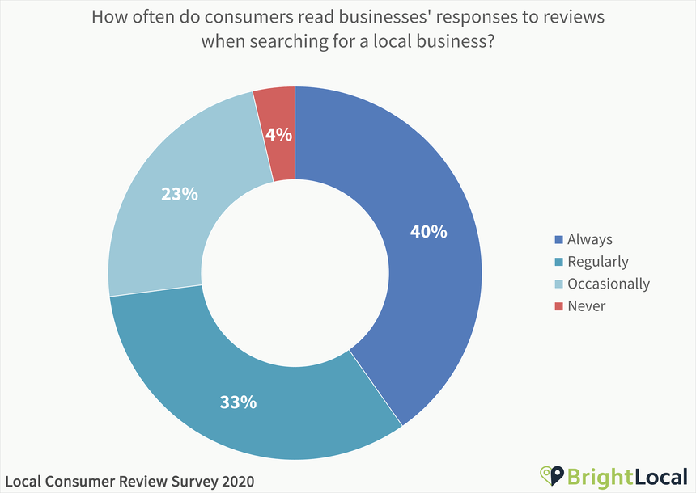
Importance of Online Reviews in Digital World
As of January 2020
Online Reviews Based Trust Ratio continues to rise day by day in more countries and cities.

Slide 6

System Objectives
Goal to achieve
Our idea is to come up with a generic recommendation system that would be able to recommend different businesses on the basis of reviews. Moreover, we will add Reinforcement Learning so that this process becomes dynamic

Slide 7
1
Recommend on the basis of feedback from group of people
2
Incorporate Multiple Businesses in single platform
System Objectives
3
System’s intelligent ratings
4
Take updated user feedback into account
5
Use Flexible State of the Art Model.

Slide 8
Pre-Decided Locations
Projects Scope
Initial Review
Language Barrier
Appointment and Bookings

Slide 9

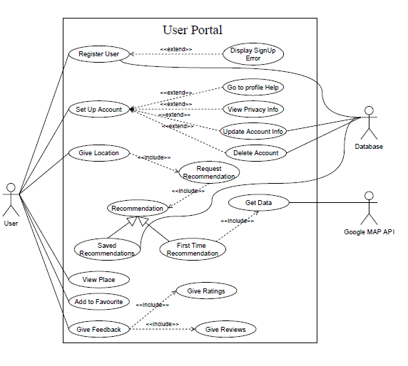
Use Cases

Slide 10
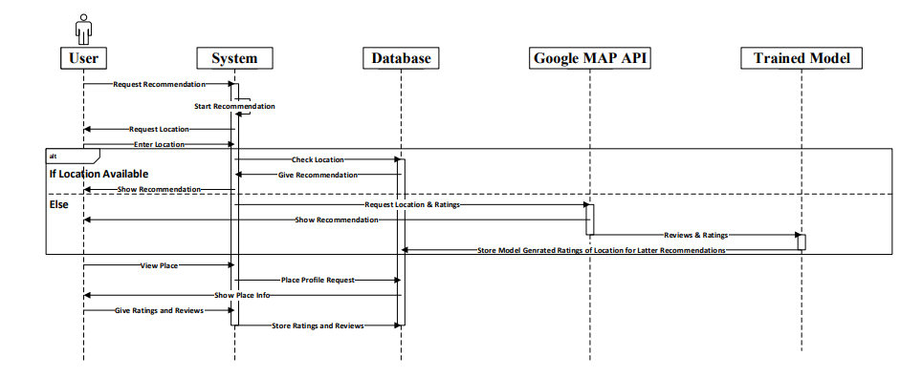
Sequence Diagram

Slide 11
Web
Web application is completed. With complete integration of model and APIs & is in the state to recommend places.
What We Have Done So Far.
Backend
Backend is also completed. Completed the connectivity of database, integration of yelp’s API, and all the necessary things to generate recommendations.
Mobile Application
UI is almost completed. Integration with backend is in progress.

Slide 12
Demo

Slide 13
Mobile Application
We will complete the integration of mobile app with our backend.
Our Goals Before Final Evaluation
Model Retraining
We will going to clean live comments of users and try to integrate reinforcement learning algorithm, that will help to make our system dynamic.
The Last Try
We are still trying and will try our best to find any better solution to recommend places in Pakistan.

Slide 14

Do you have
any questions?
Ask to us! We hope you learned something new.

